Slide 1
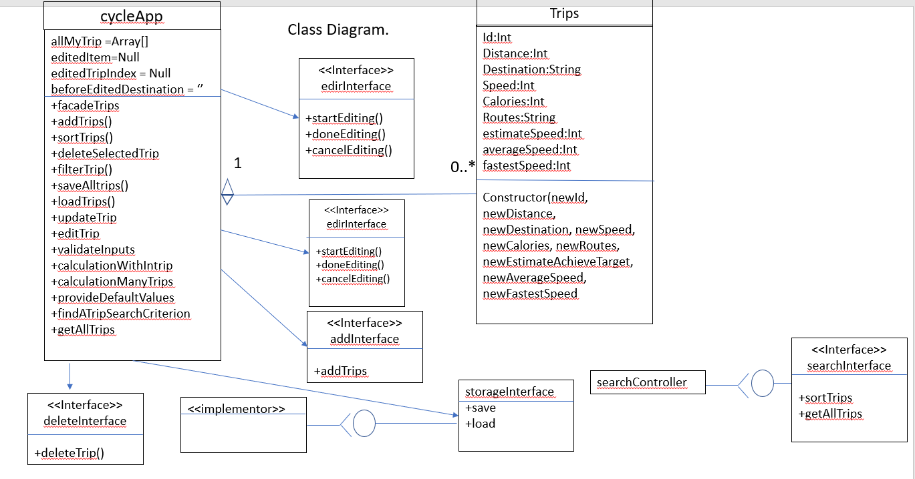
Feature 1: whole that acts as a Facade for trips in my classdiagram basically it creates whole cycle app.
Feature 2: addTrip is like my newID or new name I got addTrip which is add my trip in my list which is in under my ID or name .
Feature 3: sortTrips in my class diagram is like new destination it shows the list of trips then you can sort trips for example; arrange systematically in groups; separate according to type or through sorting you can choose your trips for certain days.
Feature 4: deleteSelectedTrip in my class diagram I made method like destination delete a selected destination in the trip class for instance that you change your mind, or you don’t want to go on that trip so, through this you can delete your trips.
Feature 5: filterTrips in my class diagram is destination filter I made a filter option once you click on that it shows your all my trips and then you can select any option the user want it for user destination.
Feature 6: saveTrip in my class diagram the method is destination I created for saving your trip or destination for example; if I got some of the favorite tracks so I can save that trip in my saving data so this case save my favorite trips and all my trips as well.
Feature 7:load in my class diagram and the method for this new speed, new destination, fastest speed it provides my trip info or data if I want to continue from where I left my trip on the last day so load data shows my trips which are uncomplete and I want to complete that.
Feature 8: update trip which I created for the editing such as; when your are on the trip and then you want to change or set your direction or destination so this state help to find new trip which is near to your current location.
Feature 9: revert code is for the previous location or destination or my average speed data for instance once the app comes on this step it shows the previous trips that I already visited.
Feature 10: validateInputs: when you input your trip location it shows the validate trips list and in my class diagram method which is when you input destinations
Feature 11: : withInATrip this shows useful info when you are on the trip it track your fastest Speed and average speed.
Feature 12: calculateManyTrips this display your fastest speed and average speed on every trip you visited or currently you are visiting it shows how fast are you gone or are you going basically it shows data for every trip..
Feature 13: defaultValue this feature help me to set my method such as fastest speed or average speed or current speed and destination info back to default value which is zero once the application comes on this it sets your values back to Zero.
Feature 14:givenASearchCriterion where you can search your new destinations and existing ones from my data this is the method which can help the user to find a trip.
Feature 15: getAllTripsButton which shows all your previous trips and destinations of trips what possible destinations I can do for a day.

Slide 2
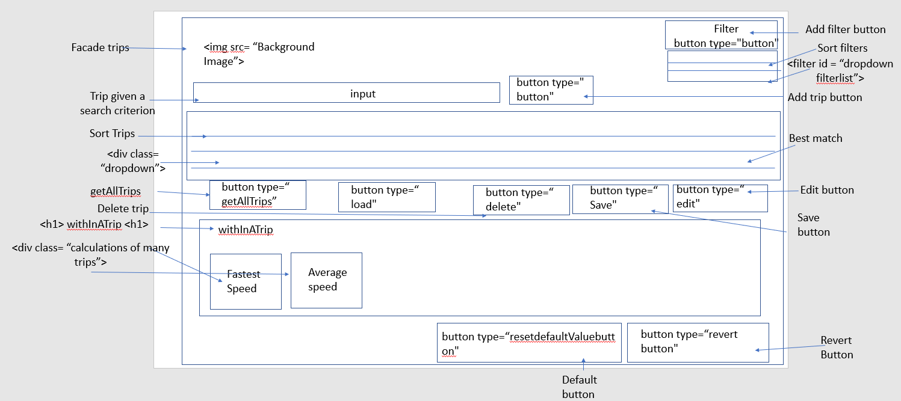
Wireframe
Feature 5: delete a selected trip button is for the deleting trip for instance that you change your mind, or you don’t want to go on that trip so, through this button you can delete your trips.
Feature 6: saveTrip in my wireframe I created the button for saving your trip for example; if I got some of the favorite tracks so I can save that trip in my saving data so this button save my favorite trips.
Feature 7: loadButton in my wireframe it provides my trip info if I want to continue from where I left my trip on the last day so load button shows my trips which are uncomplete.
Feature 8:editTrip button which I created for the editing such as; when your are on the trip and then you want change your direction or trip so this button help to find new trip which is near to your current location.
Feature 9: revertButton is for the previous location for instance once you pressed this button it shows the previous trips that I already visited.
feature 10:validateInput when you input your location it shows the validate trips list
Feature 11: withInATrip this shows useful info when you are on the trip it track your fastest Speed and average speed.
Feature 12:calculateManytrips this display your fastest speed and average speed on every trip you visited or currently you are visiting it shows how fast are you gone or are you going basically it shows data for every trip.
Feature 13:defaultValueButton this feature help me to set fastest speed or average speed data back to default value which is zero once you click on this it sets your values back to Zero.
Feature 14:givenASearchCriterion where you can search your new trips and existing ones in my wireframe is input section which can give you these features as I above mentioned.
Feature 15: getAllTripsButton which shows your all your previous trips and what possible trips I can do for a day….
Feature 1: whole that acts as a Facade for trips in my wireframe I put it background picture which shows on the whole webpage.
Feature 2: addTrip In my wireframe I got addTrip Button which is add my trip in my list.
Feature 3: sortTrips in my wireframe it shows the list of trips then you can sort trips for example; arrange systematically in groups; separate according to type or through sorting you can choose your trips for certain days.
Feature 4: filterTrips in my wireframe I made a button once you click on that it shows your all trips and then you can filter it

Slide 3
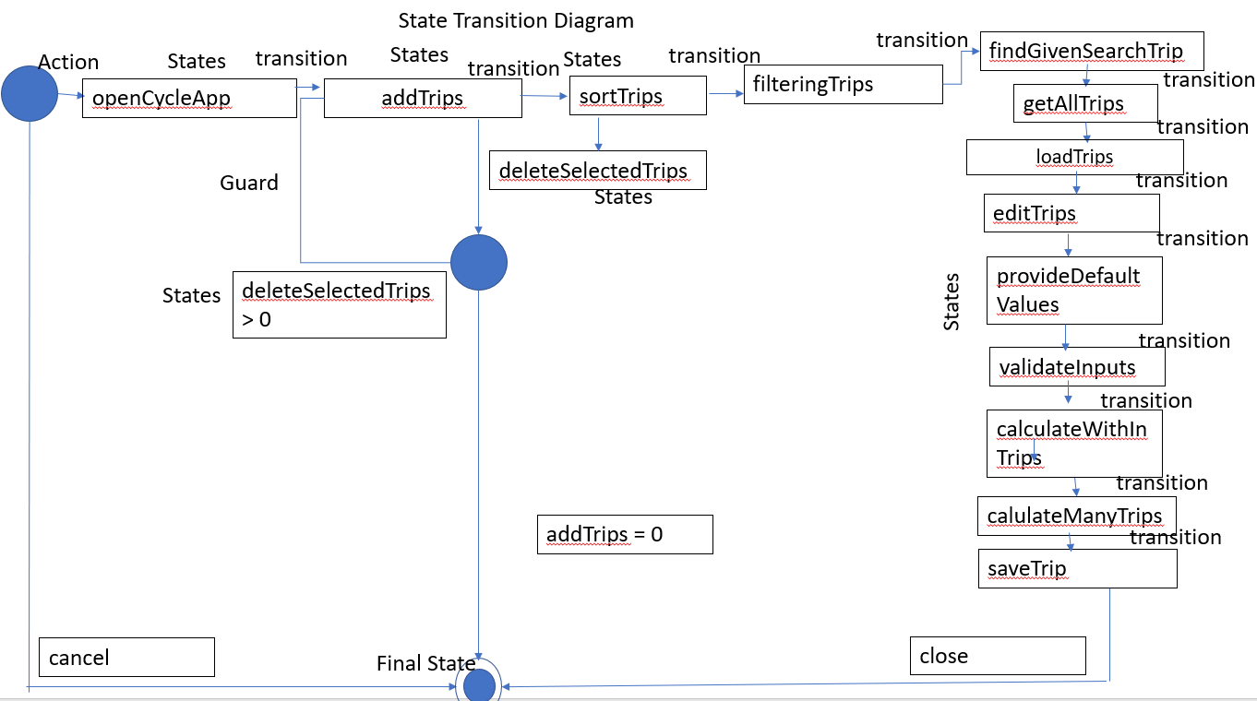
Feature 1: whole that acts as a Facade for trips in my state transition diagram I which is open my cycle app
Feature 2: addTrip In my state transition diagram I got addTrip states which is add my trip in my list.
Feature 3: sortTrips in my state transition diagram it shows the list of trips then you can sort trips for example; arrange systematically in groups; separate according to type or through sorting you can choose your trips for certain days.
Feature 4: filterTrips in my state transition diagram I made for if the user want to find certain result of trips
Feature 5: delete a selected trip state is for the deleting a trip for instance that you change your mind, or you don’t want to go on that trip so, through this states you can delete your trips.
Feature 6: saveTrip in my State Transition Diagram I created the state for saving your trip for example; if I got some of the favorite tracks so I can save that trip in my saving data so this state save my favorite trips.
Feature 7: load states in my State Transition Diagram it provides my trip info if I want to continue from where I left my trip on the last day so load states shows my trips which are uncomplete.
Feature 8:editTrip states which I created for the editing such as; when your are on the trip and then you want to change your direction or trip so this state help to find new trip which is near to your current location.
Feature 9: revert states is for the previous location for instance once the app comes on this state it shows the previous trips that I already visited.
feature 10:validateInput when you input your location it shows the validate trips list
Feature 11: withInATrip this shows useful info when you are on the trip it track your fastest Speed and average speed.
Feature 12:calculateManytrips this display your fastest speed and average speed on every trip you visited or currently you are visiting it shows how fast are you gone or are you going basically it shows data for every trip.
Feature 13:defaultValue states this feature help me to set fastest speed or average speed data back to default value which is zero once the application comes on this it sets your values back to Zero.
Feature 14:givenASearchCriterion states where you can search your new trips and existing ones in my state transition diagram is the states which can give you these features as I above mentioned.
Feature 15: getAllTrips states which shows all your previous trips and what possible trips I can do for a day….

Slide 4
Julian Siddiqui
DE211 – Assessment 2
Use Case 1
Case Description: The user adds a trip.
Actor: The user
Pre-Conditions
The app/program is working.
Add function is working.
Main Flow
The user adds a trip.
The trip goes into the system input.
Alternative Flows
A1
If the user wants to go certain trips then the user needs to filterTrips.
User can also use the search criterion.
Exception Flows
E1
The user finally find a specific Trips that the user wants to go.
The use case ends.
Use Case 2
Case Description: User sorts a trip.
Actor: The user
Pre-Conditions
The app/program is working.
Sort function is working.
Main Flow
The user sorts a trip.
The user chooses any of the sort options.
The system will sort the trips.
The app shows the sorted trips. (A1, A2, A3, A4)
Alternative Flows
A1
The user chooses the ‘best match’ option.
The app sorts from the ‘best match’ trips.
A2
The user chooses the ‘most convenient’ option.
The app sorts from the ’convenient’ ‘.
A3
The user chooses the ‘lowest’ option.
The app sorts from the ‘lowest’.
Exception Flows
E1
1. The user can delete selected Trips put some other trips as desirable.
2. The use case ends.
Use Case 3
Case Description: User filters a trip.
Actor: The user
Pre-Conditions
The app/program is working.
Filter function is working.
Main Flow
The user filters a trip.
The user chooses any of the filter options.
The app shows the filtered trips.
Alternative Flows
A1
The user chooses the ‘Speed’ option.
The app filters only the ‘Speed’.
A2
The user chooses the ‘Calorie Loss’ option.
The app filters only the ‘Calorie Loss’.
A3
The user chooses the ‘Distance’ option.
The app filters only the ‘Distance’.
A4
The user chooses the ‘Routes’ option.
The app filter only the ‘Routes’.
Use Case 4
Case Description: deleteASelectedTrip
Actor: The user
Pre-Conditions:
The app/program is working.
Search function is working.
Main Flow
The user use to delete their selected trip.
The system will validate the selected trip (A1).
The system will delete the selected trip (E1).
Alternative Flows
A1
The selection is invalid.
The case goes back to step 1.
Exception Flows
E1
The user successfully delete a selected trip.
The use case ends.
Use Case 5
Case Description: User edits a trip from added trip.
Actor: The user
Pre-Conditions:
The app/program is working.
Edit function is working.
Main Flow
The user selects a trip to edit.
The app will show the selected trip.
The user edits the selected trip.
The system will validate the input. (A1)
The edited trip gets saved to LocalStorage. (E1)
Alternative Flows
A1
The input is invalid.
The case goes back to step 1.
Exception Flows
E1
The user successfully edited the selected trip.
The use case ends.
Use Case 6
Case Description: User saves a trip to LocalStorage.
Actor: The user
Pre-Conditions:
The app/program is working.
Save function is working.
Main Flow
The user saves a trip to LocalStorage.
the system will check the given input.(A1)
The trip goes into the LocalStorage.(E1)
Alternative Flows
A1
The user input a invalid trips
The trip goes back to previous stage.
Exception Flows
E1
The user put valid trips.
The Use case finish.
Use Case 7
Case Description: User loads a trip from LocalStorage
Actor: The user
Pre-Conditions:
The app/program is working.
Load function is working.
Main Flow
The user loads a trip from LocalStorage.
The system will get all data from LocalStorage. (A1)
The system loads the selected trip. (E1)
Alternative Flows
A1
There is no trip to load.
The case goes back to case 1.
Exception Flows
E1
The user successfully loaded a trip.
The use case ends.
Use Case 8
Case Description: User update trip
Actor: The user
Pre-Conditions:
The app/program is working.
Update function is working.
Main Flow
The user can update their trips.
The app shows list of updated Trip.(A1)
The updated trips saves in localStorage.(E1)
Alternative Flows
A1
The user can choose updated trips.
The app shows other updated trips.
Exception Flows
E1
The user successfully update a trip.
The use case ends.
Use Case 9
Case Description: User revert trip
Actor: The user
Pre-Conditions:
The app/program is working.
Revert function is working.
Main Flow
The user can revert their trips.
The user can use list of revert possibility Trip back to previous position(A1)
The revert trips saves in localStorage.(E1)
Alternative Flows
A1
The user can back to their previous stage .
The app shows revert trips.
Exception Flows
E1
The user successfully revert a trip.
The use case ends.
Use Case 10
Case Description: User validate trip
Actor: The user
Pre-Conditions:
The app/program is working.
Validate function is working.
Main Flow
The user can validate their trips.
The app shows list of validate Trips.(A1)
The app shows validate trips. (E1).
Alternative Flows
A1
The user put invalid trips.
The app goes to previous stage.
Exception Flows
E1
The user input validate trips.
The use case ends.
Use Case 11
Case Description: User calculation withInATrip
Actor: The user
Pre-Conditions:
The app/program is working.
WithInATrip function is working.
Main Flow
The app shows calculation suchas (fastest speed, avg speed).(A1)
The app shows validate trips. (E1).
Alternative Flows
A1
The app shows wrong put calculations.
The user should hit the reset button to default values.
Exception Flows
E1
The app showing correct calculations of the trip.
The use case ends.
Use Case 12
Case Description: User calculationAcrossManyTrips
Actor: The user
Pre-Conditions:
1. The app/program is working.
2. acrossManyTrips function is working.
Main Flow
1. The app shows calculation of each different trips (fastest speed, avg speed).(A1)
2. The app shows validate trips. (E1).
Alternative Flows
A1
1. The app shows wrong put calculations.
2. The user should hit the reset button to default values.
Exception Flows
E1
1. The app showing correct calculations each of different trip.
2. The use case ends.
Use Case 13
Case Description: User calculation provideDefaultValues
Actor: The user
Pre-Conditions:
1. The app/program is working.
2. provideDefaultValues function is working.
Main Flow
The user can hit the default value button to get default values of calculation suchas (fastest speed, avg speed).
The app can show the wrong values (A1)
The app shows the correct default values trips. (E1).
Alternative Flows
A1
1. The app shows wrong put calculations.
2. The app can go back to their previous stage of default values.
Exception Flows
E1
1. The app showing correct default values of the trip.
2. The use case ends.
Use Case 14
Case Description: User trip given a search criterion
Actor: The user
Pre-Conditions:
The app/program is working.
search criterion function is working.
Main Flow
The user can search their trips using search input bar
The app can check trips of the given search input.(A1)
The app search the correct Trips(E1).
Alternative Flows
A1
The User put invalid search criterion.
The app goes back to their previous stage.
Exception Flows
E1
The app showing correct trips with the correct search criterion.
The use case ends.
Use Case 15
Case Description: User Get all trips
Actor: The user
Pre-Conditions:
The app/program is working.
Get all trips function is working.
Main Flow
The user can get all their trips history from the day the user started to use this app
The app can check all user trips .(A1)
The app shows all correct Trips(E1).
Alternative Flows
A1
The app can shows wrong user trips.
The app goes back to their previous stage.
Exception Flows
E1
The app showing correct all user trips.
The use case ends.
Feature 1: whole that acts as a Facade for trips in my use case diagram which shows the whole system boundary.
Feature 2: addTrip In my use case diagram I got addTrip which is add trips in my list.
Feature 3: sortTrips in my use case diagram it shows the list of trips then you can sort trips for example; arrange systematically in groups; separate according to type or through sorting you can choose your trips for certain days.
Feature 4: filterTrips in my use case diagram I made a filter option once you click on that it shows your all trips and then you can filter it that option the user want it.
Use Case Diagram
Feature 5: delete a selected trip case is for the deleting a trip for instance that you change your mind, or you don’t want to go on that trip so, through this you can delete your trips.
Feature 6: saveTrip in my use case diagram I created for saving your trip for example; if I got some of the favorite tracks so I can save that trip in my saving data so this case save my favorite trips.
Feature 7: load case in my use case diagram it provides my trip info if I want to continue from where I left my trip on the last day so load states shows my trips which are uncomplete.
Feature 8:editTrip case which I created for the editing such as; when your are on the trip and then you want to change your direction or trip so this state help to find new trip which is near to your current location.
Feature 9: revert case is for the previous location for instance once the app comes on this case it shows the previous trips that I already visited.
feature 10:validate case when you input your location it shows the validate trips list
Feature 11: withInATrip this shows useful info when you are on the trip it track your fastest Speed and average speed.
Feature 12:calculateManytrips this display your fastest speed and average speed on every trip you visited or currently you are visiting it shows how fast are you gone or are you going basically it shows data for every trip.
Feature 13:defaultValue case this feature help me to set fastest speed or average speed data back to default value which is zero once the application comes on this it sets your values back to Zero.
Feature 14:givenASearchCriterion case where you can search your new trips and existing ones from my data is the case which can give you these features as I above mentioned.
Feature 15: getAllTrips case which shows all your previous trips and what possible trips I can do for a day….

Slide 5
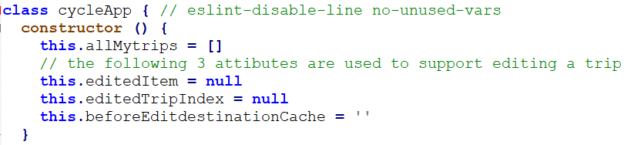

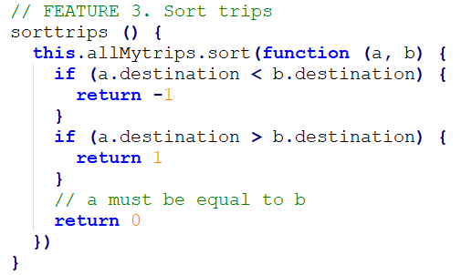
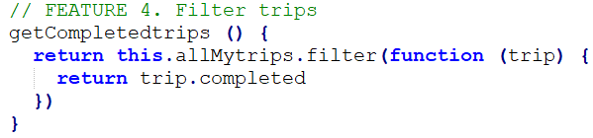
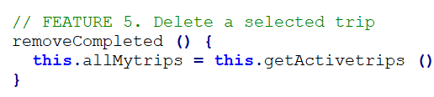
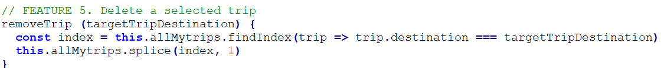
Code
FEATURE 1. Create a whole that acts as a Facade for trips which my class cycle app which act as a application
Feature 2. addTrip In my code which is add trips (in my code there are 3 attributes and one
is with trim method trim() method removes whitespace from both sides of a string.)
Feature 3: sortTrips in my code it shows the list of trips then you can sort trips for example; arrange systematically in groups; separate according to type or through sorting you can choose your trips for certain days.
Feature 4: filterTrips in my code I made a filter option once you click on that it shows your allmy trips and then you can select any option the user want it.
Feature 5: delete a selected trip is for the deleting a trip for instance that you change your mind, or you don’t want to go on that trip so, through this you can delete your trips.

Slide 6
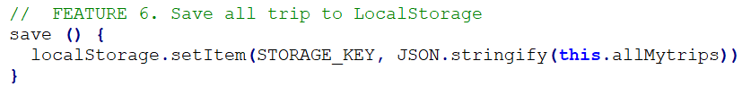
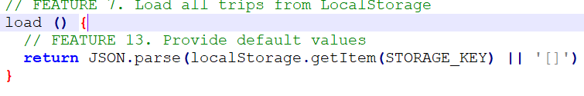
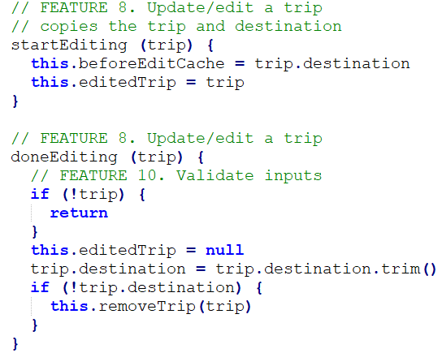
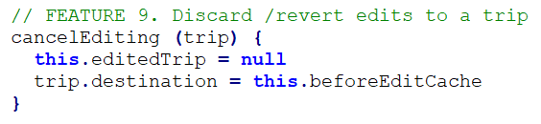
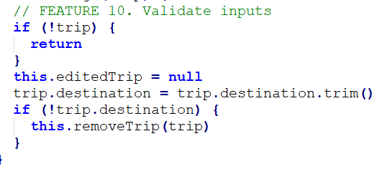
Feature 6: saveTrip in my code I created for saving your trip for example; if I got some of the favorite tracks so I can save that trip in my saving data so this case save my favorite trips and all my trips as well.
Feature 7: load in my code it provides my trip info if I want to continue from where I left my trip on the last day so load code shows my trips which are uncomplete.
Feature 8:editTrip code which I created for the editing such as; when your are on the trip and then you want to change or set your direction or destiantion so this state help to find new trip which is near to your current location.
Feature 9: revert code is for the previous location tr for instance once the app comes on this case it shows the previous trips that I already visited.
feature 10:validate code when you input your trip location it shows the validate trips list
Feature 11: withInATrip this shows useful info when you are on the trip it track your fastest Speed and average speed but I have not done in my code
Feature 12:calculateManytrips this display your fastest speed and average speed on every trip you visited or currently you are visiting it shows how fast are you gone or are you going basically it shows data for every trip. but I have not done in my code

Slide 7
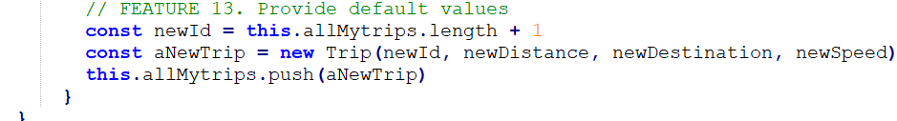
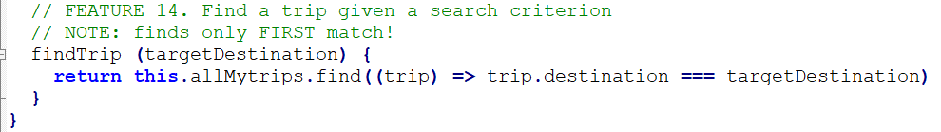

Feature 13:defaultValue code this feature help me to set fastest speed or average speed or current speed and destination info back to default value which is zero once the application comes on this it sets your values back to Zero.
Feature 14:givenASearchCriterion code where you can search your new trips and existing ones from my data is the code which can help the user to find a trip.
Feature 15: getAllTrips code which shows all your previous trips and what possible trips I can do for a day….

Slide 8
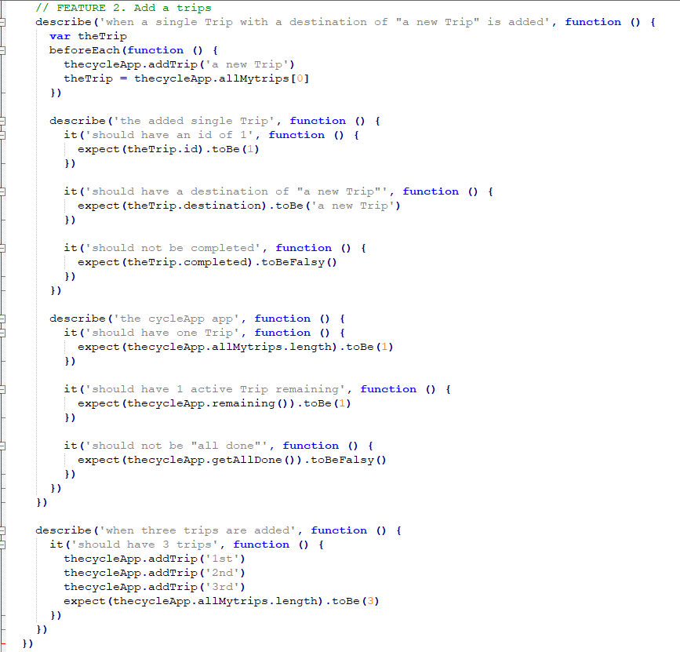
Unit tests
FEATURE 1. Create a whole that acts as a Facade for trips which my class cycle app which act as a application

Slide 9
FEATURE 2. Feature 2. addTrip In my code which is add trips (in my code there are 3 attributes and one

Slide 10
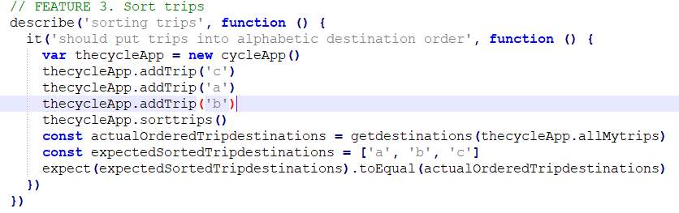
Feature 3: sortTrips in my unitTest it shows the list of trips then you can sort trips for example; arrange systematically in groups; separate according to type or through sorting you can choose your trips for certain days.

Slide 11
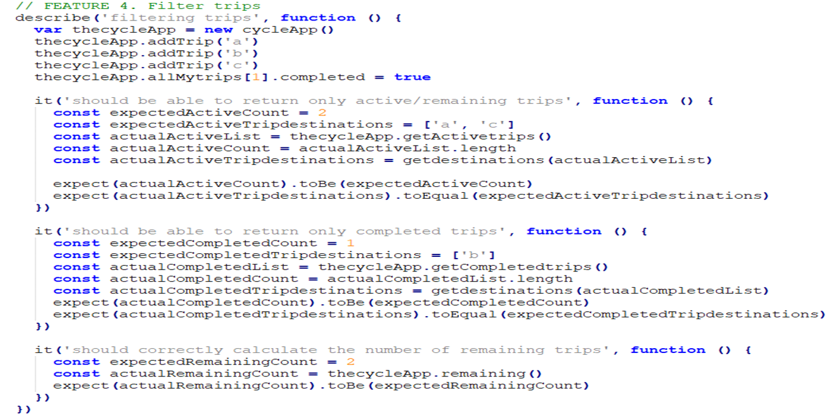
Feature 4: filterTrips in my code I made a filter option once you click on that it shows your allmy trips and then you can select any option the user want it.

Slide 12
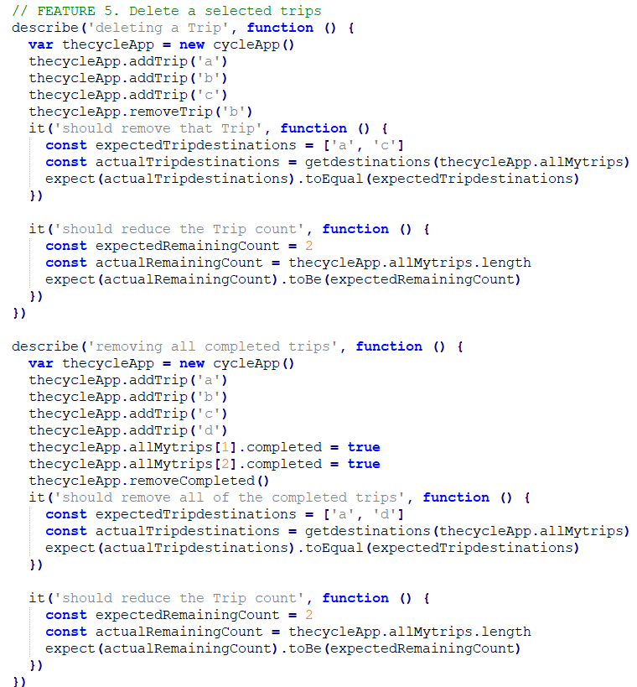
Feature 5: delete a selected trip is for the deleting a trip for instance that you change your mind, or you don’t want to go on that trip so, through this you can delete your trips.

Slide 13
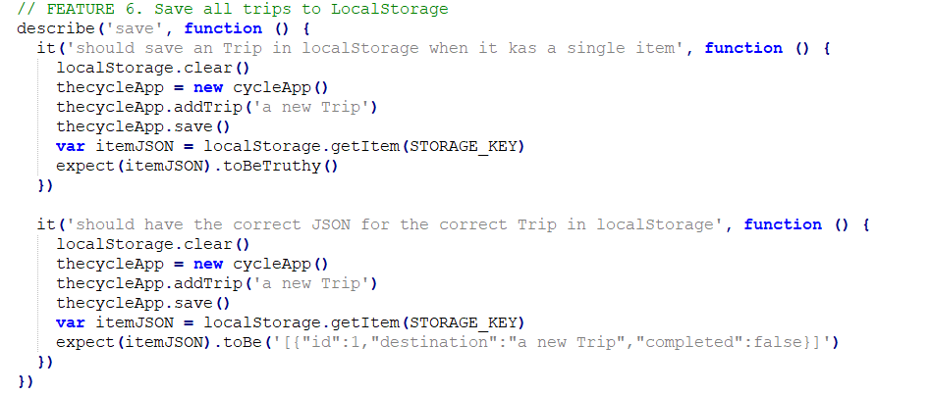
saveTrip in my code I created for saving your trip for example; if I got some of the favorite tracks so I can save that trip in my saving data so this case save my favorite trips and all my trips as well.

Slide 14
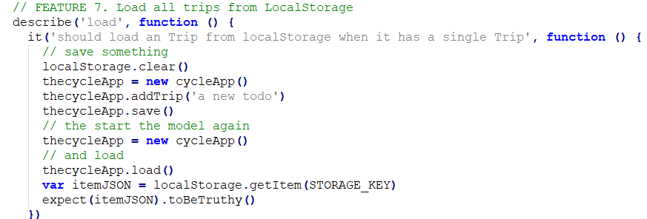
Feature 7: load in my code it provides my trip info if I want to continue from where I left my trip on the last day so load code shows my trips which are uncomplete.

Slide 15
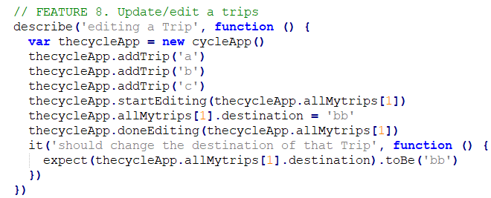
Feature 8: load in my code it provides my trip info if I want to continue from where I left my trip on the last day so load code shows my trips which are uncomplete.

Slide 16
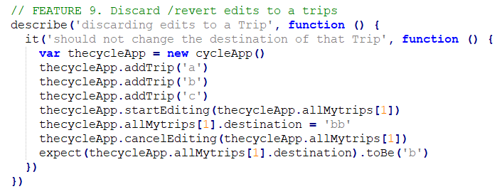
Feature 9: revert code is for the previous location tr for instance once the app comes on this case it shows the previous trips that I already visited.

Slide 17
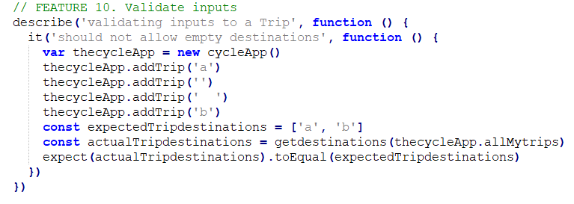
Feature 10:validate code when you input your trip location it shows the validate trips list

Slide 18
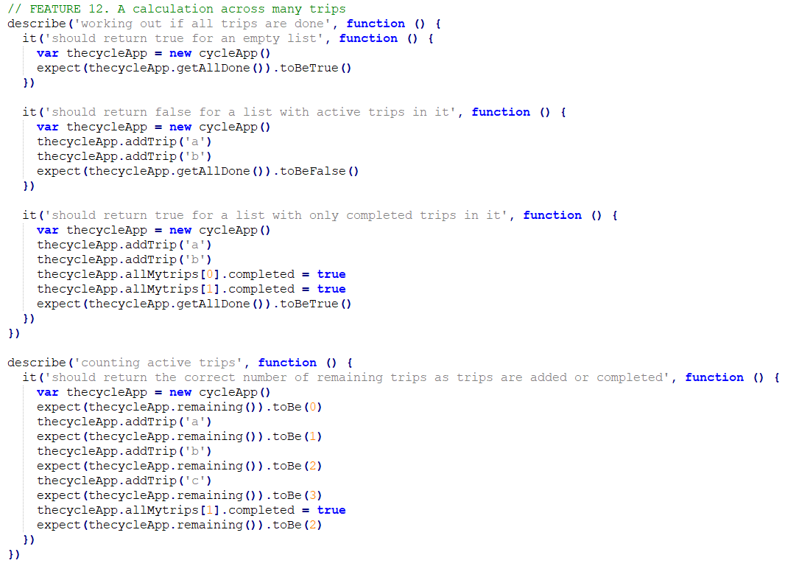
Feature 11: withInATrip this shows useful info when you are on the trip it track your fastest Speed and average speed but I have not done in my code
Feature 12:calculateManytrips this display your fastest speed and average speed on every trip you visited or currently you are visiting it shows how fast are you gone or are you going basically it shows data for every trip. but I have not done in my code

Slide 19
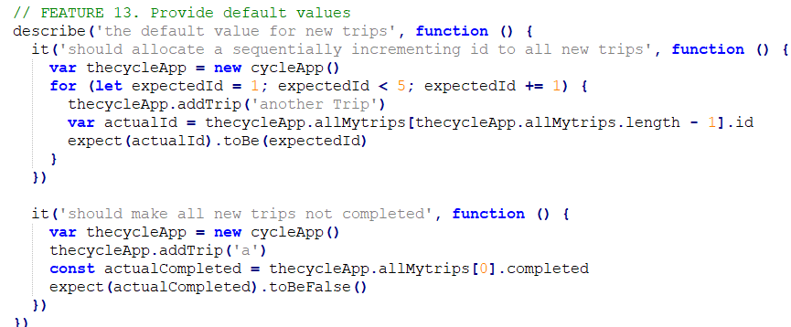
Feature 13:defaultValue code this feature help me to set fastest speed or average speed or current speed and destination info back to default value which is zero once the application comes on this it sets your values back to Zero.

Slide 20
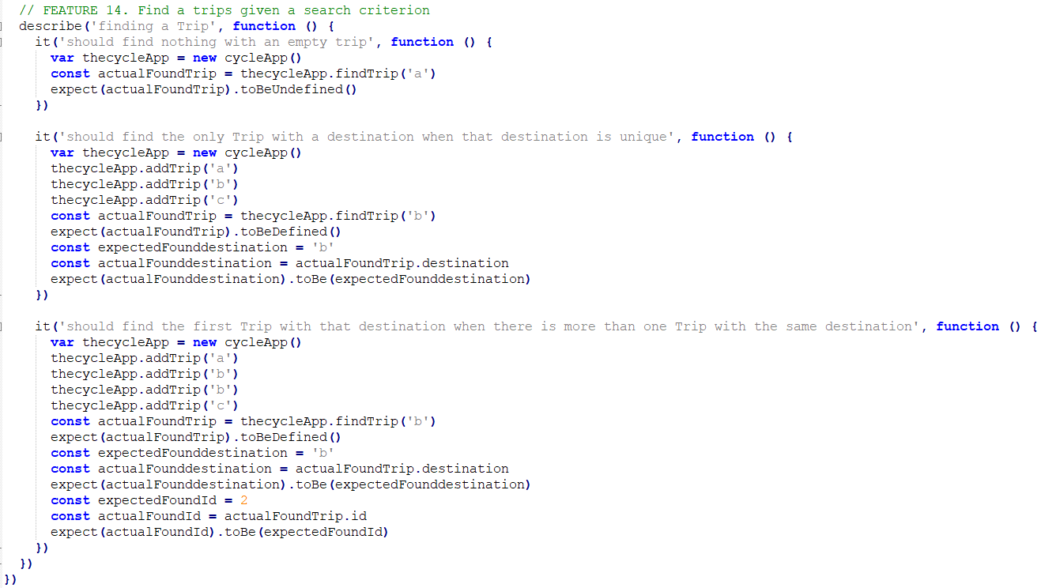
givenASearchCriterion code where you can search your new trips and existing ones from my data is the code which can help the user to find a trip.

